Slide 1

Basic Structure of Computers
Chapter 1
Lecture: 1-6
Book: Carl Hamacher 5e
Course Outcome: Explain the interconnection between functional units of a computer system and various factors that affects the performance of a computer[Level 2: Understanding]

Slide 2

Functional units(T1.2)

Slide 3
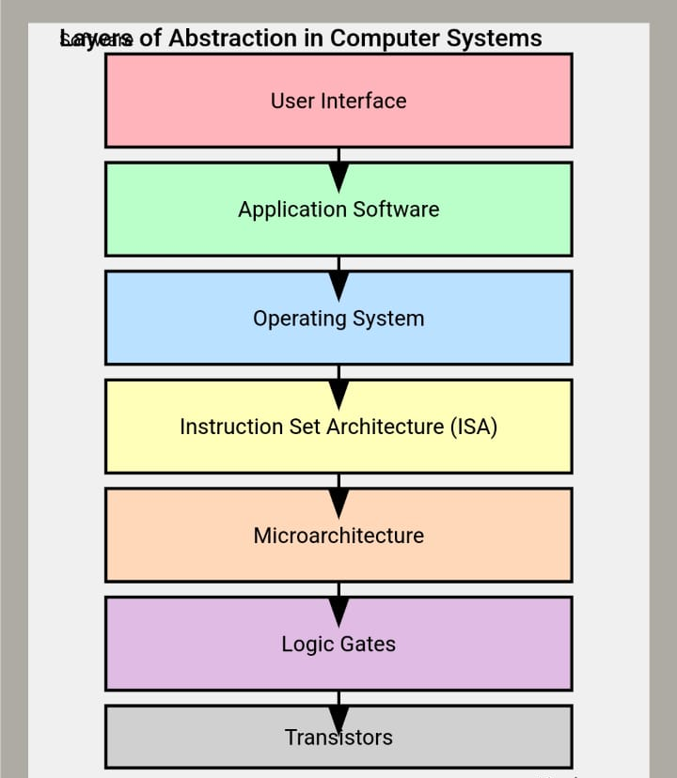
Abstraction

Slide 4
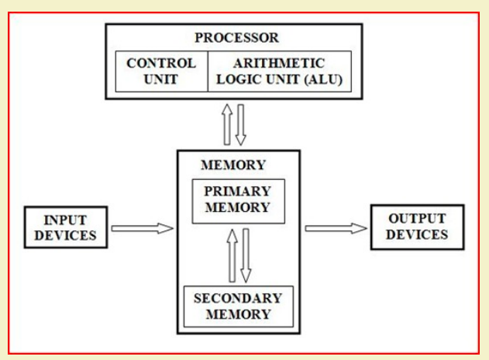

Slide 5
The Journey of an Application to Binary: From High-Level Code to Hardware
Whenever we perform any task on a computer—whether it's writing a program in C++ or playing a game—we are interacting in a high-level, human-readable language. However, the processor, the brain of the computer, understands only one language: Binary (0s and 1s). So, how does our high-level code reach the processor? Let's trace this journey with a simple C code example.
Our Example: int c = a + b;
Let's assume the value of a is 5 and b is 12. We want the computer to add these two numbers and store the result in c.
Level 5: The Application (Your High-Level Code)
The journey begins with the code you write. It is easy for humans to understand.
// High-Level Language (C) int a = 5; int b = 12; int c = a + b;
What is this? This is an abstract instruction. We have told the computer "what to do," but not "how to do it." The processor does not understand int, a, b, or c.

Slide 6
Level 4: The Compiler (Translator #1)​
Now, the Compiler comes into play. A compiler is a translator that converts your high-level C code into a language that is a bitcloser to the hardware: Assembly Language.​
The Compiler's job: To break down int c = a + b; into simple, step-by-step instructions.​
Level 3: Assembly Language (A Language Closer to Hardware)​
The compiler will translate the C code into Assembly code something like this (this is a simplified example):​
; Assembly Language LOAD R1, A ; Load the value from memory location A into Register R1 (R1 = 5) LOAD R2, B ; Load the valuefrom memory location B into Register R2 (R2 = 12) ADD R3, R1, R2 ; Add R1 and R2 and place the result in Register R3 (R3 = 17)STORE R3, C ; Store the value from Register R3 into memory location C ​
What is this? These are instructions for the machine, but still in a human-readable form (using symbolic names like LOAD, ADD).Each line represents a very basic operation that the processor can perform. We have now reached the "how to do it" level.​
Level 2: The Assembler (Translator #2)​
The processor still doesn't understand words like LOAD or ADD. Now, it's the Assembler's turn. An assembler is a second translator that converts these symbolic assembly instructions into their true form: Machine Code (Binary).​
The Assembler's job: To convert every instruction (like ADD R3, R1, R2) into a unique binary pattern.​

Slide 7
Level 1: Machine Code (The Processor's Native Language)​​
The assembler will convert the ADD R3, R1, R2 instruction into a 32-bit binary number. For example:​​
000000 00001 00010 00011 00000 100000​​
What is this? This is Machine Code. This sequence of 0s and 1s is the actual "instruction" that the processor understands
and executes. Different parts of this binary pattern tell the processor:​​
000000 and 100000: This is the "ADD" operation.​​
00001: This is Register R1.​​
00010: This is Register R2.​​
00011: This is Register R3.​​
Level 0: The Hardware (Transistors and Voltages)​​
Ultimately, even these 0s and 1s are abstract. In reality, they are electrical signals inside the processor.​​
Logic 1: A high voltage (e.g., +1.8V)​​
Logic 0: A low voltage (e.g., 0V)​​
These voltage levels turn millions of microscopic switches, called transistors, ON or OFF. When the binary code for the
ADD instruction reaches the processor, these voltages activate the specific transistors that perform the "addition" operation.​​
Conclusion: The Role of the Von Neumann Architecture​​
This entire journey—from C code to voltages—is the core of Computer Organization and Architecture. Tomorrow,
when we study the functional units of the Von Neumann Architecture (CPU, Memory, I/O), we will ask you these questions:​​
Where is this machine code (000000...) stored? (Memory Unit)​​
Which component reads and understands this code? (Control Unit)​​
Which component takes the data from the registers and performs the "ADD" operation on it? (Arithmetic Logic Unit - ALU)​​
In this way, you will see that an entire hardware ecosystem works together to execute a single, simple C statement.​​

Slide 8

Central Processing Unit (CPU)
The CPU is often considered the "brain" of a computer system.
It consists of several functional units, including the control unit and the arithmetic logic unit (ALU).
The control unit coordinates the activities of other units, interprets instructions, and controls the flow of data within the CPU.
The ALU performs arithmetic and logical operations, such as addition, subtraction, multiplication, and comparison.

Slide 9
Memory Unit
Two classes of storage
Primary storage
Fast
Programs must be stored in memory while they are being executed
Large number of semiconductor storage cells
Processed in words (Example)
Address
RAM and memory access time
Memory hierarchy – cache, main memory
Secondary storage – larger and cheaper

Slide 10

Memory Unit
The memory unit is responsible for storing and retrieving data and instructions. It consists of two primary types of memory:
Random Access Memory (RAM): RAM is the main memory that provides temporary storage for data and instructions during program execution. It is volatile, meaning its contents are lost when the power is turned off.
Read-Only Memory (ROM): ROM is non-volatile memory that stores firmware or permanent instructions. It contains essential system instructions and data that are not modified during normal operation.
Magnetic Disk, which uses direction of magnetization of tiny magnetic particles on a metallic surface to store data. Access times vary depending on the location being accessed, and is used as secondary memory
Flash Memory, which is replacing magnetic disks as secondary memory devices. They are faster, but smaller in size as compared to disk.

Slide 11
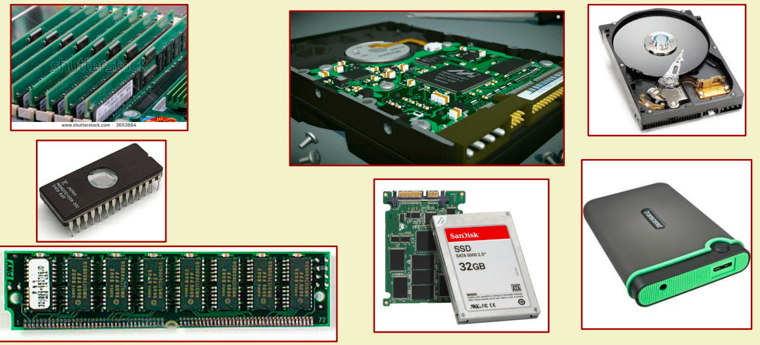
Memory Unit
The processor only has direct access to the primary memory.
The memory system is implemented as a hierarchy of several levels
L1 cache, L2 cache, L3 cache, primary memory, secondary memory.
Objective is to provide faster memory access at affordable cost.

Slide 12
Input/Output (I/O) Unit
The I/O unit facilitates communication between the computer and external devices.
It manages the exchange of data between the computer's memory and input/output devices such as keyboards, mice, printers, storage devices, and networking devices.
The I/O unit coordinates data transfer, buffering, and error handling to ensure efficient communication.

Slide 13
Control Unit
The control unit manages the execution of instructions within the CPU.
It fetches instructions from memory, decodes them, and generates control signals to coordinate the activities of other units.
The control unit ensures that instructions are executed in the correct sequence and that data is manipulated and stored as intended.

Slide 14
What is the role of control unit?
Acts as the nerve center that senses the states of various functional units and sends control signals to control their states.
To carry out a specific operation (say, R1 <- R2 + R3), the control unit must generate control signals in a specific sequence.
Enable the outputs of registers R2 and R3.
Select the addition operation.
Store the output of the adder circuit into register R1.
When an instruction is fetched from memory, the operation (called opcode) is decoded by the control unit, and the control signals issued.

Slide 15

Arithmetic Logic Unit (ALU)
The ALU performs arithmetic and logical operations on data.
It can perform operations such as addition, subtraction, multiplication, division, AND, OR, NOT, and comparison operations.
The ALU operates on binary data, manipulating bits and bytes to carry out various calculations and logical operations.

Slide 16
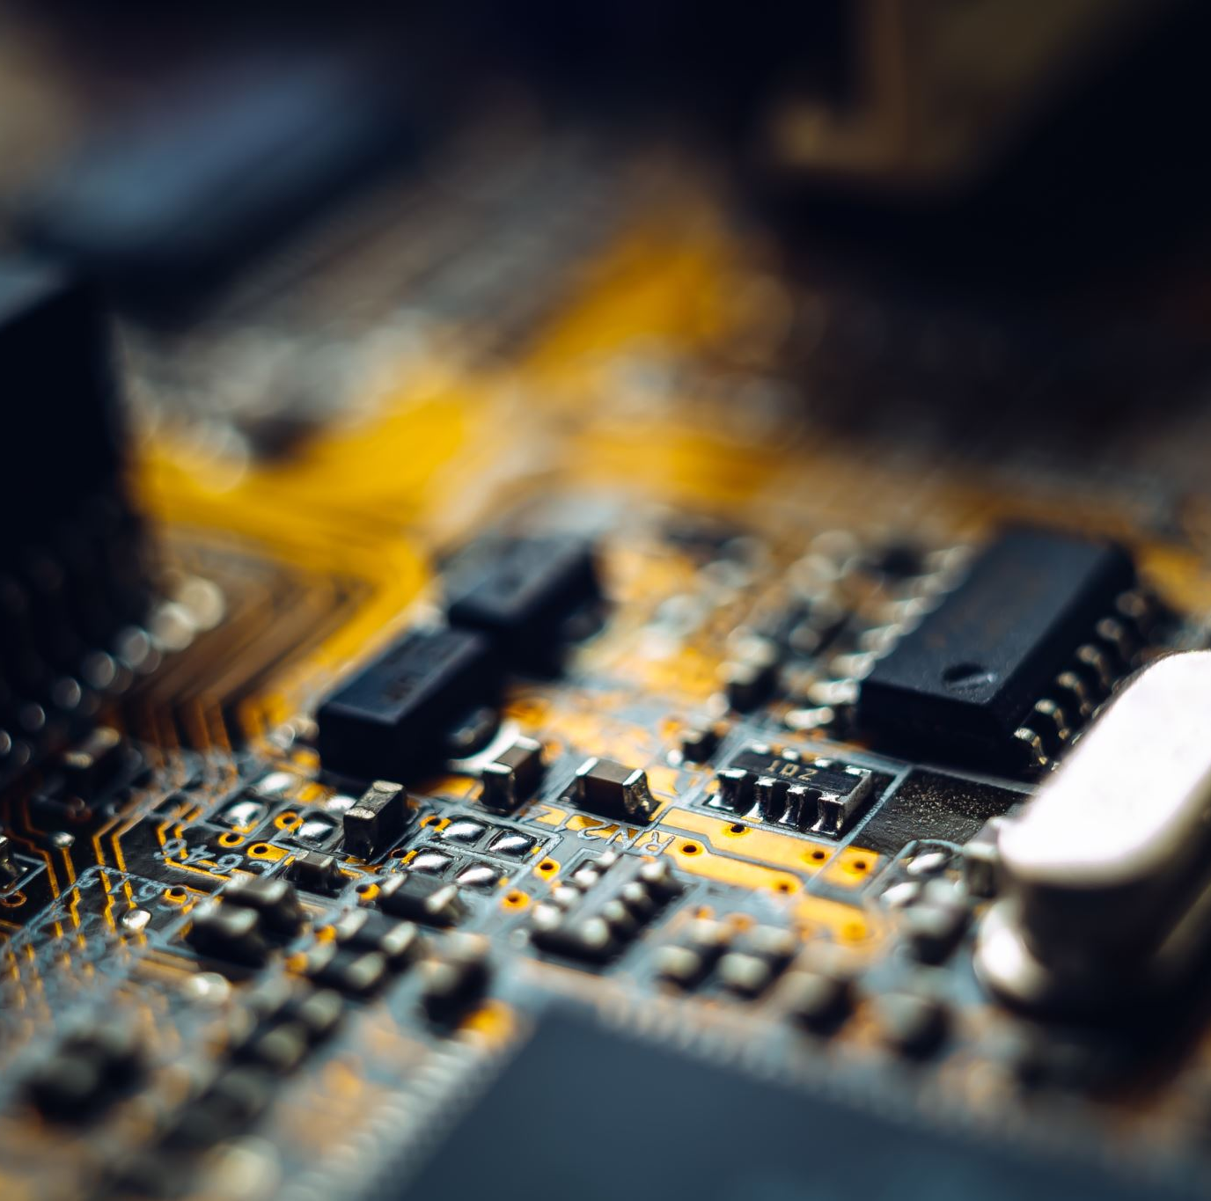
Cache Memory
Cache memory is a small, high-speed memory unit located between the CPU and main memory.
It stores frequently accessed instructions and data, reducing the time required to access information from the main memory.
Cache memory acts as a buffer, improving overall system performance by providing faster access to frequently used data.

Slide 17


Slide 18
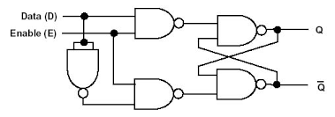
CPU Registers
Program Counter (PC)
Instruction Register (IR)
Accumulator (ACC)
Memory Address Register (MAR)
Memory Data Register (MDR)
Index Register
Stack Pointer (SP)
Status Register (FLAGS)
General-Purpose Registers (GPRs)

Slide 19

CPU Registers
Registers can be categorized into special-purpose registers and general-purpose registers based on their intended use and functionality:
Special-Purpose Registers:
Program Counter (PC): Holds the memory address of the next instruction to be fetched.
Instruction Register (IR): Stores the currently fetched instruction.
Memory Address Register (MAR): Holds the memory address being accessed.
Memory Data Register (MDR): Temporarily stores data read from or written to memory.
Stack Pointer (SP): Points to the top of the stack for managing function calls and local variables.
Status Register (FLAGS): Contains condition code flags indicating the status or results of operations.

Slide 20
CPU Registers
General-Purpose Registers:
Accumulator (ACC): Used for temporary storage of intermediate results during arithmetic and logical operations.
Index Register: Used for index addressing or array operations.
General-Purpose Registers (GPRs): Versatile registers used for various purposes, such as storing data, memory addresses, or intermediate results.

